Slide 1
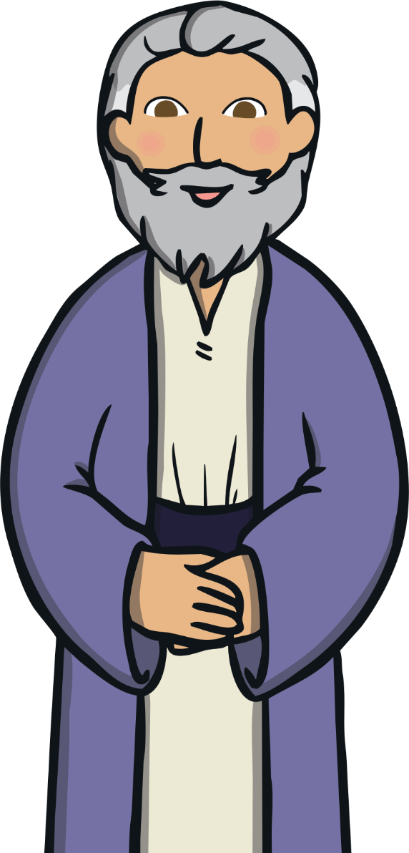

Slide 2
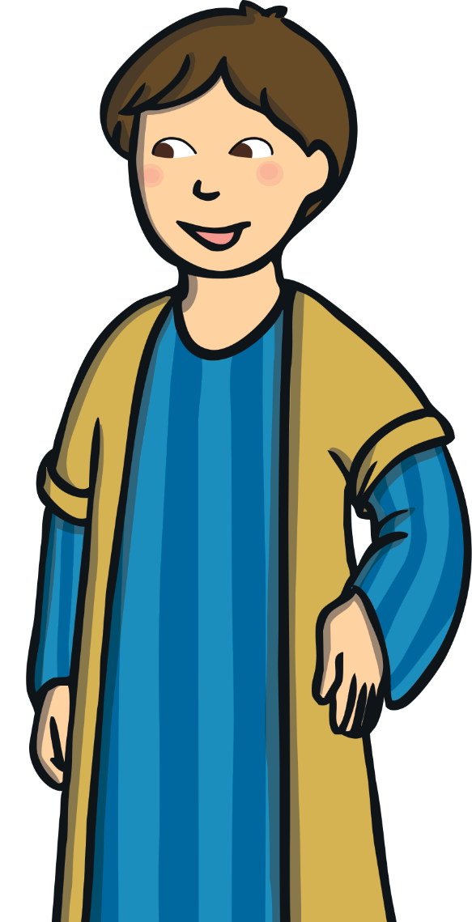
There was once a man who had two sons.

Slide 3
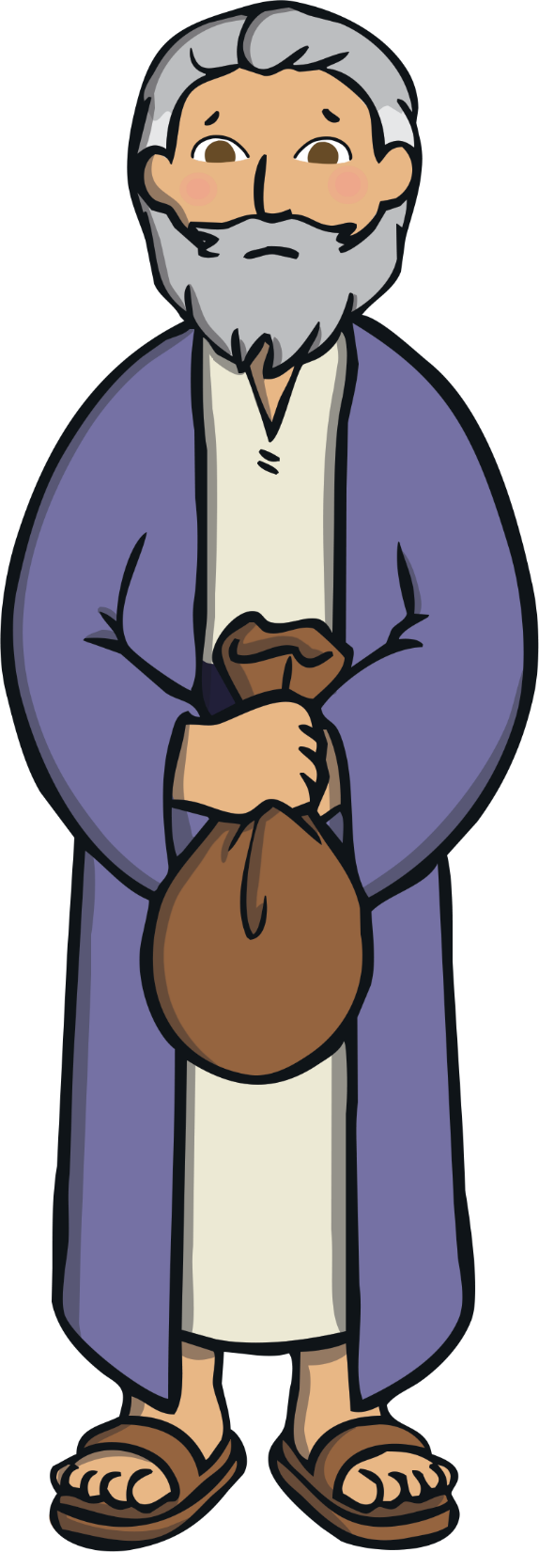
One day, the youngest son asked his father for his inheritance money.

Slide 4
The father thought about it and divided what he owned between them, giving his sons their inheritance.

Slide 5
The youngest son moved far away and very soon spent all of his money.

Slide 6
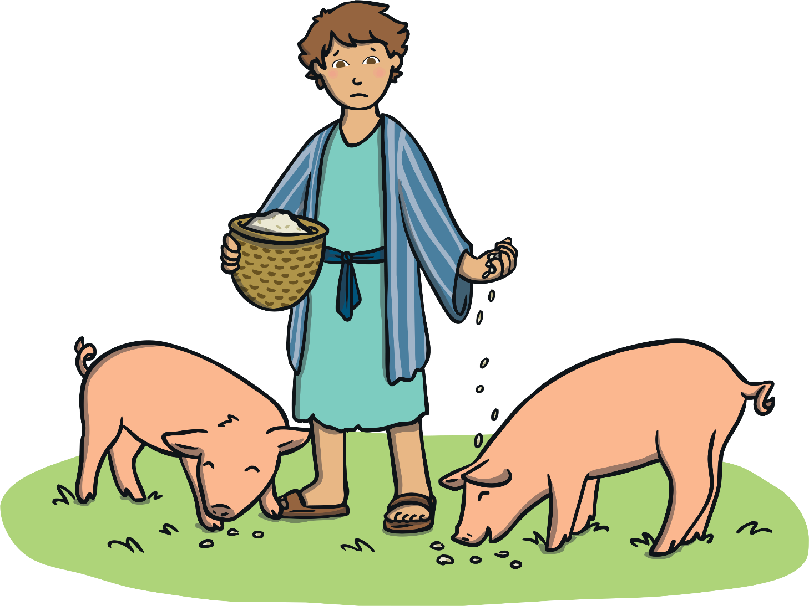
He was very hungry and had no place to live, so he decided to get a job. He was given a job feeding pigs but no one would give him anything to eat.

Slide 7
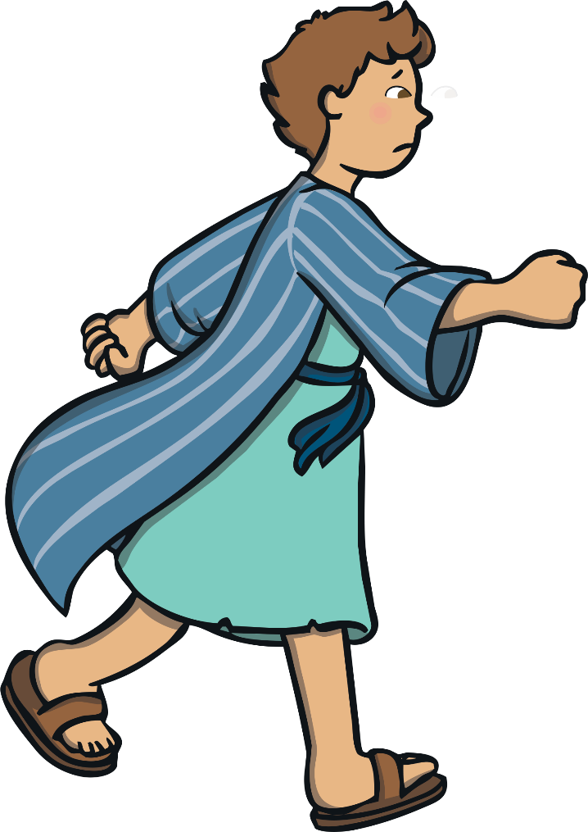
The son was very sad and very sorry for what he had done. Back home, even his father’s hired men were fed well. He decided to go back home, apologize, and ask his father for a job as a servant.

Slide 8
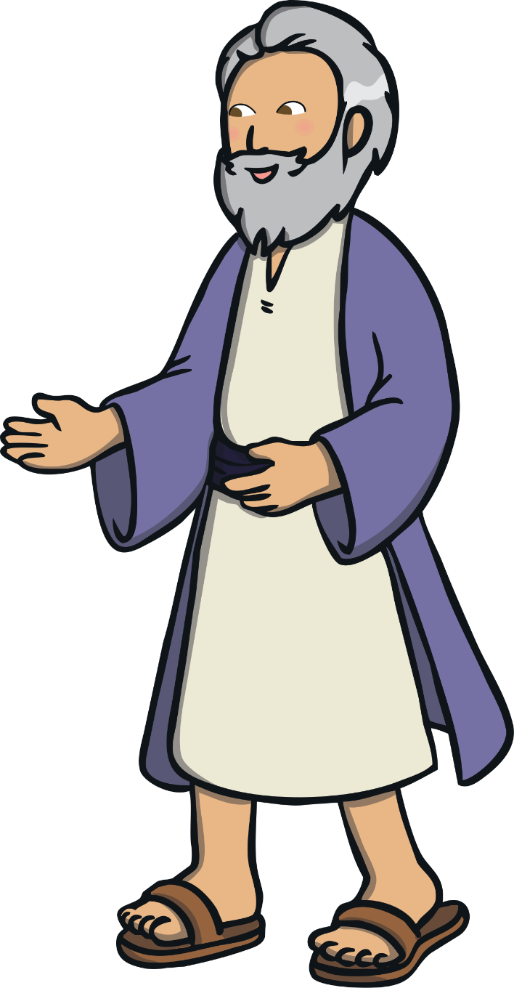
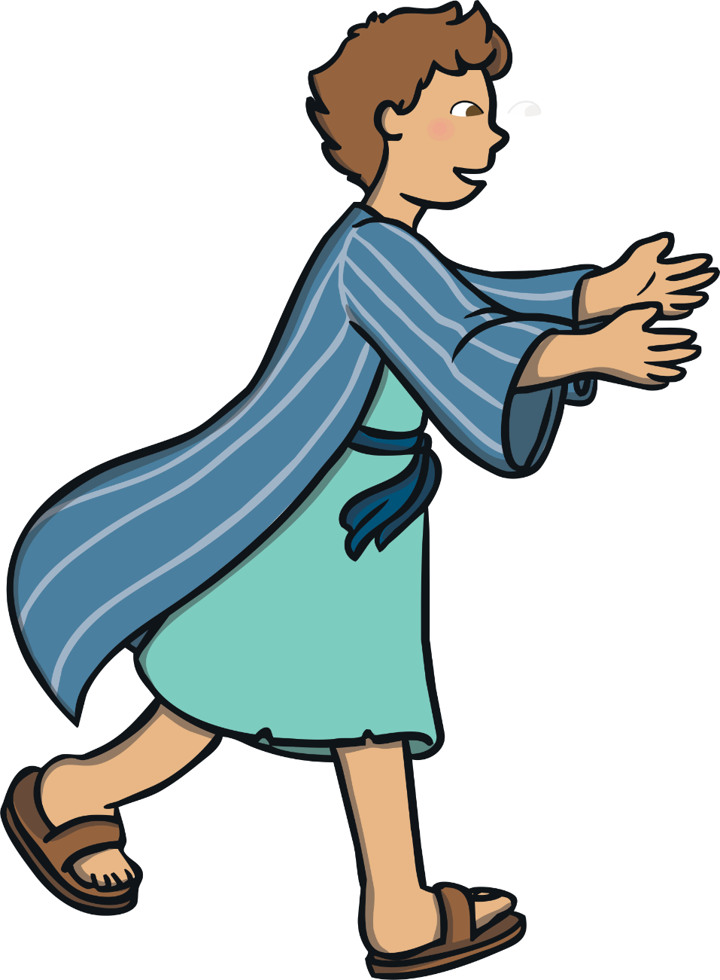
When the father saw his youngest son returning, he was filled with great joy and ran to greet his returning son. He hugged and kissed the boy.

Slide 9
The Son said “Father, I have sinned against heaven and against you.” The father forgave his son.

Slide 10
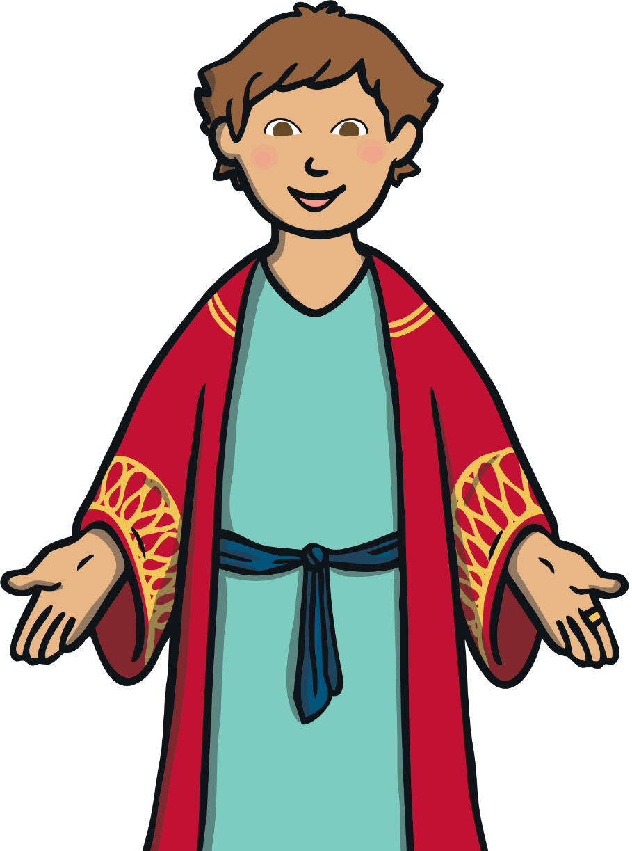
The father dressed him up in the best robe, some new sandals and put a ring on his finger. The father was so happy that his son had returned that he threw a great feast to celebrate!

Slide 11
The older son never left his father and did all the right things. He was jealous and not happy about the party.

Slide 12
The father explained: “Son, you have always been with me, but now we have to celebrate and be glad, since this son that was lost is now found!”

