Slide 1
Philippians 4:6 (NLT)
“Don’t worry about anything;
instead, pray about everything. Tell God what you need and thank Him for all He has done.

Slide 5
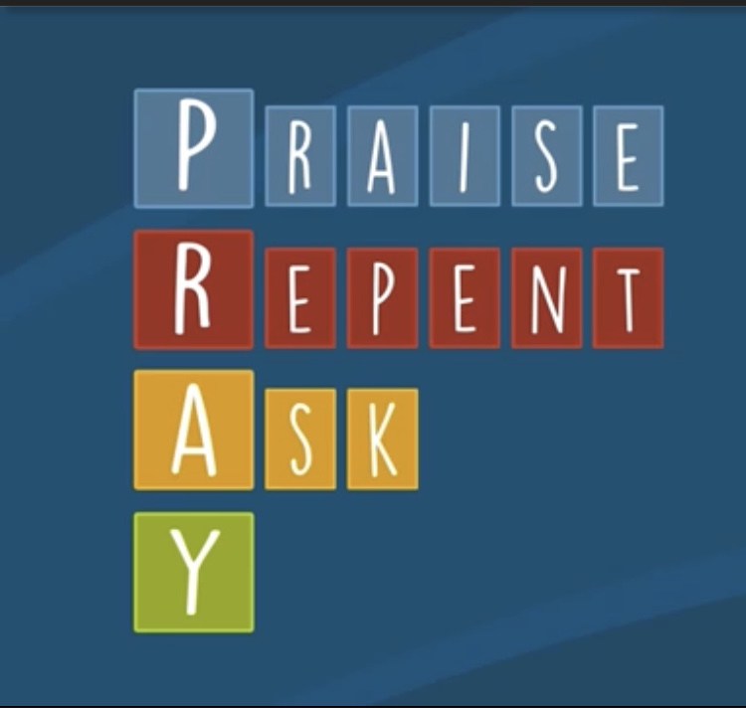

Slide 6
